Slide 1
Ch1.What is deep learning?
Francois Chollet
Deep Learning with Python
발표자: 김다연

Slide 2
목차
Artificial intelligence, machine learning, and deep learning
2. Before deep learning: a brief history of machine learning
3. Why deep learning? Why now?

Slide 3
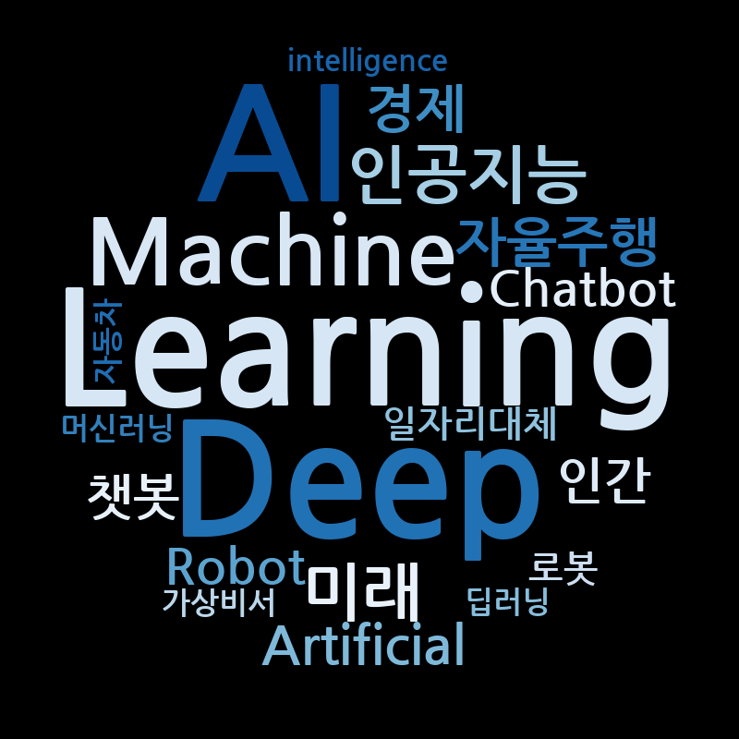
1. Artificial intelligence, machine learning, and deep learning

Slide 4
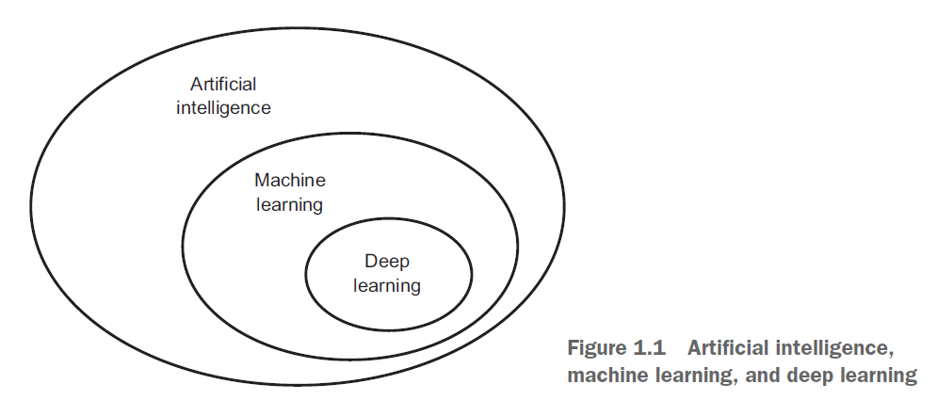
AI, machine learning, and deep learning
AI : 기계가 사람처럼 행동하고 사고하도록
만드는 것
ML : 기계가 학습하는 능력
DL : 신경망을 통해 학습하는 것

Slide 5
Artificial intelligence
the effort to automate intellectual tasks normally performed by humans.
In the 1950s
asking whether computers could be made to “think”
symbolic AI approach
In the 1950s ~ the late 1980s
programmers handcraft a sufficiently large set of explicit rules for manipulating knowledge.
problem
symbolic AI suitable to solve well-defined, logical problems Ex) chess
Intractable to figure out explicit rules for solving more complex, fuzzy problems,
Ex) image classification, speech recognition, and language translation.
=> New approach : machine learning

Slide 6
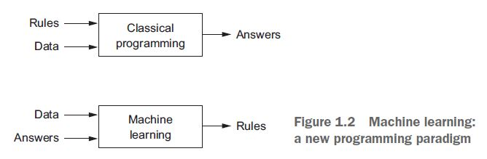
Machine learning
⇨ 컴퓨터가 특정 작업을 수행하는 방법을 스스로 배울 수 있는가?
컴퓨터가 데이터를 보고 규칙을 자동으로 학습할 수 있는가?
Symbolic AI approach | Machine Learning(New approach )
사람이 컴퓨터가 수행하도록 명령해야 한다. 사람이 데이터 처리규칙을 제공해야 한다. | 컴퓨터가 스스로 특정 작업을 수행하는 방법을 배울 수 있다. 컴퓨터가 데이터를 통해 규칙을 학습할 수 있다.
규칙을 새로운 데이터에
적용해 다양한 답을
찾을 수 있다.

Slide 7
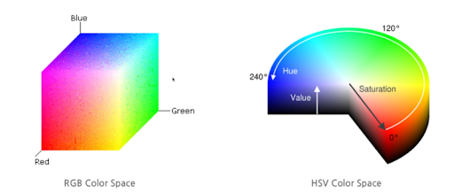
Machine learning
예상 출력의 예시들 (Answers) 을 통해 데이터 처리 작업을 실행하는 규칙을 발견한다.
need three things
Input data
Examples of the expected output
A way to measure whether the algorithm is doing a good job
실제 출력과 예상 출력의 차이(피드백) ⇨조정(=학습)
데이터를 의미있게 변환하는 것
input data의 유용한 representations(표현)을 배우는 것
Representations : 예상 출력에 더 가까워질 수 있는 것
representation이란?
데이터를 표현하거나 인코딩 하기 위해 데이터를 보는 다른 방법 Ex) color 이미지 => RGB vs HSV
=> transformations of the data

Slide 8
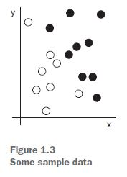
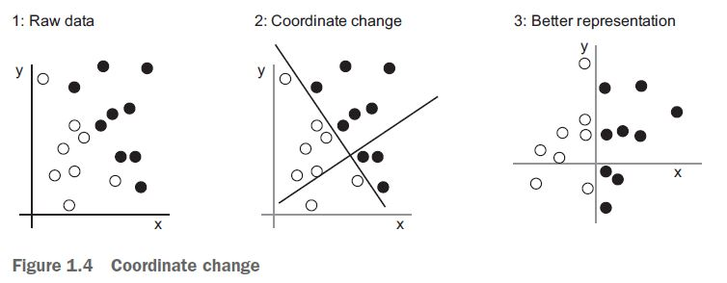
Machine learning
- Input : coordinates of our points
- Output : colors of our points
- A way to measure : the percentage of points that are being correctly classified
black/white classification problem
=> a simple rule: “Black points are such that x > 0,” or “White points are such that x < 0.”

Slide 9
Deep Learning
a specific subfield of machine learning
데이터에서 학습표현에 대한 새로운 해석
의미있는 표현의 연속적인 계층을 학습하는데 중점을 둔다
depth of the model : How many layers contribute to a model of the data
Difference
machine learning : focus on learning only one or two layers of representations of the data (shallow learning)
deep learning : involves tens or even hundreds of successive layers of representations
learned via neural networks(신경망)
Structured in literal layers stacked on top of each other.

Slide 10
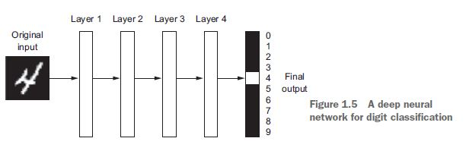
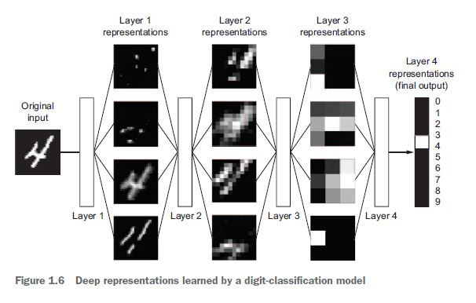
Deep Learning
Information goes through successive filters
and comes out increasingly purified
- Input : digit image
- Output : digit recognition
=>Deep Learning
: 데이터 표현을 학습하는 다단계 방법

Slide 11
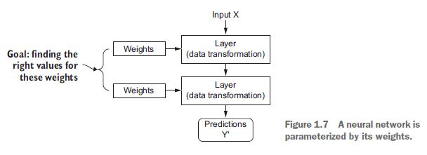
How Deep Learning works
Weights
The specification of what a layer does to its input data
일련의 숫자
learning
finding a set of values for the weights of all layers in a network
⇨ the network will correctly map example inputs to their associated targets.
Problems
a deep neural network can contain tens of millions of parameters
modifying the value of one parameter will affect the behavior of all the others

Slide 12
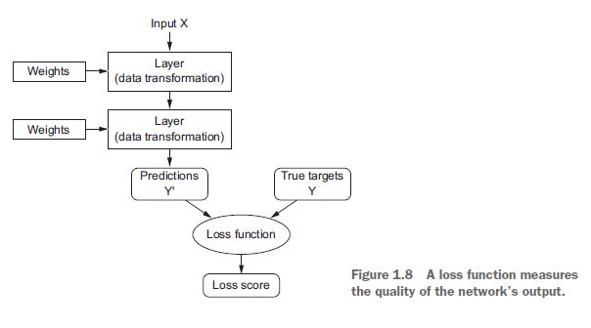
How Deep Learning works
loss function
measure how far this output is from what you
expected.
takes the predictions of the network and the true target(what you wanted the network to output)
computes a distance score
capturing how well the network has done on this specific example

Slide 13
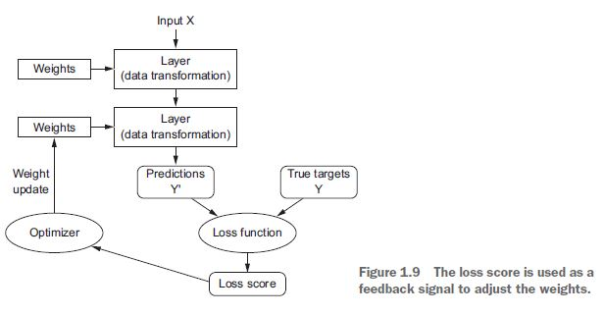
How Deep Learning works
Optimizer
to use loss score to adjust the value of the weights a little, in a direction that will lower the loss score for the current example
the weights of the network are assigned random values
its output is far from what it should ideally be, and the loss score is accordingly very high.
the weights are adjusted a little in the correct direction, and the loss score decreases.
=> training loop

Slide 14
2. Before deep learning: a brief history of machine learning
Probabilistic modeling Naive Bayes
Early neural networks
Kernel methods SVM(Support Vector Machine)
Decision trees, random forests, and gradient boosting machines
Back to neural networks
What makes deep learning different
The modern machine-learning landscapes

Slide 15
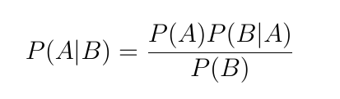
Probabilistic modeling
Probabilistic modeling
the application of the principles of statistics to data analysis.
one of the earliest forms of machine learning
still widely used to this day
Naive Bayes algorithm
a type of machine-learning classifier
based on applying Bayes’ theorem
assume input data are all independent
logistic regression
classification algorithm
simple and versatile nature
Bayes’ theorem

Slide 16
Early neural networks
in the 1950s
core ideas of neural networks were investigated in toy forms
the approach took decades to get started.
in the mid-1980s
multiple people independently rediscovered the Backpropagation algorithm
started applying it to neural networks
first successful practical application
in 1989 from Bell Labs
Yann LeCun combined the earlier ideas of convolutional neural networks and backpropagation
applied them to the problem of classifying handwritten digits.
LeNet
in the 1990s
used by the United States Postal Service to automate the reading of ZIP codes on mail envelopes
Backpropagation algorithm
a way to train chains of parametric operations using gradient-descent optimization

Slide 17
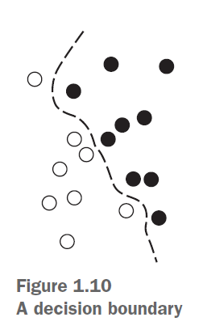
Kernel methods SVM
aim
- solving classification problems by finding good decision boundaries
between two sets of points belonging to two different categories.
decision boundary
a line or surface separating your training data into two spaces
corresponding to two categories.
Steps
1. The data is mapped to a new high-dimensional representation where the
decision boundary can be expressed as a hyperplane
2. A good decision boundary is computed by trying to maximize the distance
between the hyperplane and the closest data points from each class
(maximizing the margin)
=> This allows the boundary to generalize well to new samples outside of the training dataset.

Slide 18
Kernel methods SVM
At the time of development
good performance on simple classification problems
one of the few machine-learning methods backed by extensive theory
amenable to serious mathematical analysis
Problems
hard to scale to large datasets
didn’t provide good results for perceptual problems such as image classification
extracting useful representations manually (a step called feature engineering)
difficult and brittle

Slide 19
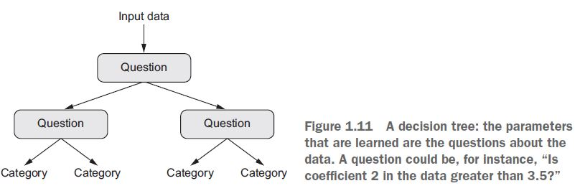
Decision trees, random forests, and gradient boosting machines
Decision trees
flowchart-like structures that let you classify input data points or predict output values given inputs
easy to visualize and interpret
Random Forest algorithm
building a large number of specialized decision trees and
then ensembling their outputs
gradient boosting
- training new models that specialize in addressing the weak points of the previous models

Slide 20
Back to neural networks
In 2011
Dan Ciresan from IDSIA
GPU-trained deep neural networks
the first practical success of modern deep learning
Since 2012
ImageNet
deep convolutional neural networks (convnets) have become the go-to algorithm for all computer vision tasks
It has completely replaced SVMs and decision trees in a wide range of applications.

Slide 21
What makes deep learning different
Deep learning also makes problem-solving much easier,
because it completely automates what used to be the most crucial step in a machine-learning workflow
feature engineering -> Deep learning
humans had to go to great lengths to make the initial input data more amenable to processing
Deep learning completely automates

Slide 22
The modern machine-learning landscapes
Kaggle
gradient boosting
machines and deep learning.
XGBoost Library, Keras Library
Python, R

Slide 23
3.Why deep learning? Why now?
in 1989
- convolutional neural networks and backpropagation were already well understood
in 1997
- The Long Short-Term Memory (LSTM) algorithm was developed and has barely changed since
why did deep learning only take off after 2012?
Hardware
Datasets and benchmarks
Algorithmic advances

Slide 24
Hardware
Between 1990 and 2010
off-the-shelf CPUs became faster by a factor of approximately 5,000.
Throughout the 2000s,
GPU 개발
NVIDIA, AMD
-> A small number of GPUs started replacing massive clusters of CPUs in various highly parallelizable applications, beginning with physics modeling.
Deep neural networks, consisting mostly of many small matrix multiplications, are also highly parallelizable
TITAN X 개발
TPU 개발

Slide 25
Data
the exponential progress in storage hardware
Internet -> collect image datasets, video datasets, and natural-language datasets
Ex) image tags on Flickr ,You-Tube videos, Wikipedia
ImageNet dataset
consisting of 1.4 million images that have been hand annotated with 1,000 image categories
(1 category per image).
public competitions
Kaggle
since 2010
an excellent way to motivate researchers and engineers to push the envelope
Having common benchmarks that researchers compete to beat

Slide 26
Algorithms
gradient propagation
The feedback signal used to train neural networks would fade away as the number of layers increased
2009 – 2010
Better activation functions for neural layers
Better weight-initialization schemes, starting with layer-wise pretraining, which was quickly abandoned
Better optimization schemes, such as RMSProp and Adam
in 2014, 2015, and 2016,
batch normalization, residual connections, and depthwise separable convolutions.

Slide 27



Investment and democratization
최근 몇 년 사이 AI 산업에 대한 투자가 증가했으며 앞으로도 이어질 것이다.
과거 소수의 사람만 소유했던 딥러닝이 이제는 기본적인 Python 스크립팅 기술만으로도 가능하다.
Theano, TensorFlow, Keras

Slide 28
Will it last?
Simplicity
- Deep learning removes the need for feature engineering, replacing complex, brittle, engineering-heavy pipelines with simple, end-to-end trainable models that are typically built using only five or six different tensor operations.
Scalability
Deep learning is highly amenable to parallelization on GPUs or TPUs,
Deep-learning models are trained by iterating over small batches of data, allowing them to be trained on datasets of arbitrary size.
Versatility and reusability
deep-learning models can be trained on additional data without restarting from scratch,
making them viable for continuous online learning—an important property for very large production models.
trained deep-learning models are repurposable and thus reusable

Slide 29
Q&A

